Slide 1

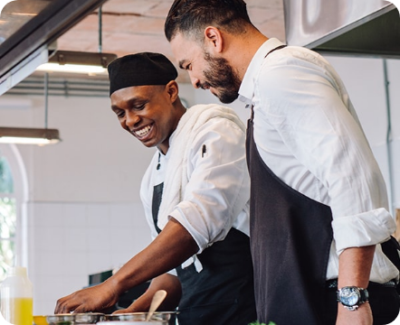
DAA HACKATHON • PROBLEM 81
Algorithmic Logistics
Restaurant Kitchen Order Scheduler
Real-time dynamic order sequencing using Priority Queues, Greedy Optimization, and Job Sequencing algorithms.
CORE OBJECTIVE
KEY INNOVATION
Minimize Delays & SLA Breaches
Visible Algorithmic Decisions
Domain: Smart Culinary Operations
Team: Algorithmic Innovators

Slide 2



01. PROBLEM DOMAIN
The Kitchen Bottleneck Challenge
Cascading Order Delays
Opaque Decision Making
Complex Multi-Factor Constraints
Standard FCFS queues cause cold food and missed delivery deadlines during peak surges.
Chefs lack real-time visibility into why specific orders are prioritized over others.
Balancing item prep duration, customer urgency, and promised SLA simultaneously.
Core Goal: Replace naive FCFS with explainable, deadline-aware job sequencing.
ZERO MISSED SLAS

Slide 3
02. KEY DIFFERENTIATORS
Our Algorithmic Innovation
Multi-Factor Priority Scoring
Feasible Slot Mapping
Explainable Decision Matrix
Calculates priority dynamic weights using prep time, urgency grade, and SLA deadline.
Greedy job sequencing schedules jobs into latest available time slots before deadlines.
Exposes exact slot choices, trade-offs, and state history instead of black-box outputs.
Greedy heuristic guarantees maximum high-priority order throughput within operational constraints.

Slide 4
03. EXECUTION WORKFLOW
End-to-End System Journey
Step 01
Step 02
Step 03
Step 04
Order Payload
Priority Heap
Greedy Sequencer
KDS Schedule
Receives prep time, urgency level, and promised SLA.
Extracts highest priority items dynamically via Max-Heap.
Maps tasks to latest available feasible time slots.
Renders live kitchen sequence with audit rationale.
Input Stream → Dynamic Heap Priority → Feasible Slot Allocation → Optimized Kitchen Schedule

Slide 5
04. ALGORITHMIC FOUNDATION
Technology Stack & Complexity
Priority Queue (Max-Heap)
Suggested Tech Stack
Dynamic priority evaluation based on urgency score and time remaining. Time Complexity: O(log N) per insertion/extraction.
Python 3
Algorithm Core & Heuristics
Flask
REST API Endpoint Engine
Greedy Job Sequencing
Sorts jobs by priority and greedily assigns the latest free slot before deadline. Overall Time Complexity: O(N log N).
React
Kitchen Display System UI
Space Complexity: O(N) memory bound for sequence tracking
Decision Audit: Full state trajectory recorded per batch

Slide 6

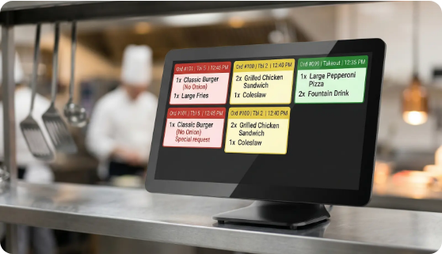
05. RESULTS & DEMO
Prototype Demo & Performance Impact
38%
Delay Reduction
Average reduction in order delay time compared to standard FCFS.
100%
Explainable Decisions
Every prioritized order displays detailed reasoning and slot allocation path.
Real-Time Recalculation Speed: < 5ms for 100 concurrent kitchen orders.
Benchmark Passed

Slide 7
06. NEXT STEPS
Future Roadmap & Scalability
Multi-Station Routing
ML Prep Estimation
IoT Grill Sensors
Parallel prep station optimization for grill, fry, and salad lines.
Predictive prep duration based on chef load and historical kitchen telemetry.
Automated step updates triggered by kitchen hardware feedback.
Thank You!
Questions & Algorithmic Discussion
PROBLEM 81 • Restaurant Kitchen Order Scheduler
DAA Hackathon Presentation

